Slide 1

Enhancing Public Health: a Better Approach for Face Mask Detection Using Transfer Learning to Prevent Airborne Disease
Presented by
Naimul Hasan Shadesh
ID: CSE1903018059
Department of Computer Science and Engineering
Sonargaon University(SU)
Supervised by
Arifur Rahaman
Assistant Professor & Coordinator
Department of Computer Science and Engineering
Sonargaon University (SU)

Slide 2
Contents
Introduction
Problem Statement
Data Collection
Data Preprocessing
Methodology
Transfer Learning
Model Training
Model Evaluation
Result Analysis
Conclusion

Slide 3
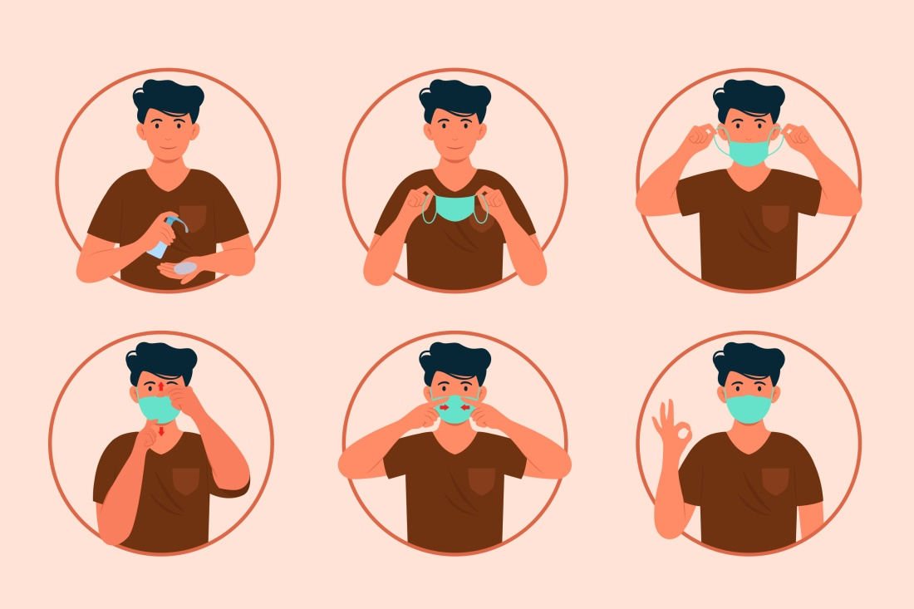
Introduction
What is a Face Mask ?
How can we improve face mask detection to bolster public safety and health measures?

Slide 4

Problem Statement
The primary objective of this research is to create an efficient and reliable face mask detection model that can be deployed in real-world scenarios. The model should be capable of detecting face masks with high accuracy and robustness, even in challenging environments with variations in mask types, lighting conditions, partial face visibility, and the presence of other facial coverings, Naqaab, Sunglasses.

Slide 5
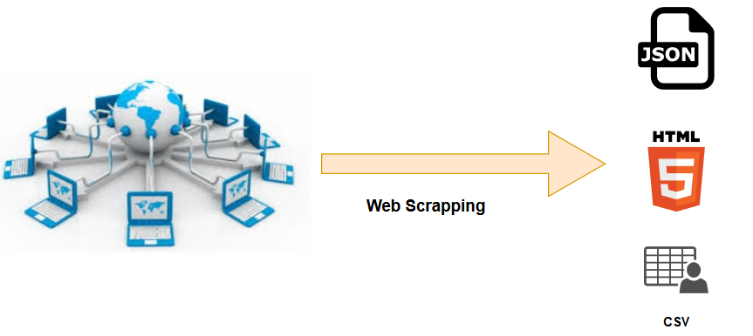
Data Collection
Step 1: Public Datasets
Step 2: Custom Image Collection
Step 3: Web Scraping for Additional Data

Slide 6
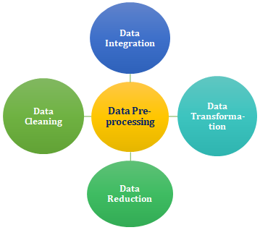
Data Preprocessing
Data Cleaning
Data integration
Data Transformation
Data Reduction

Slide 7
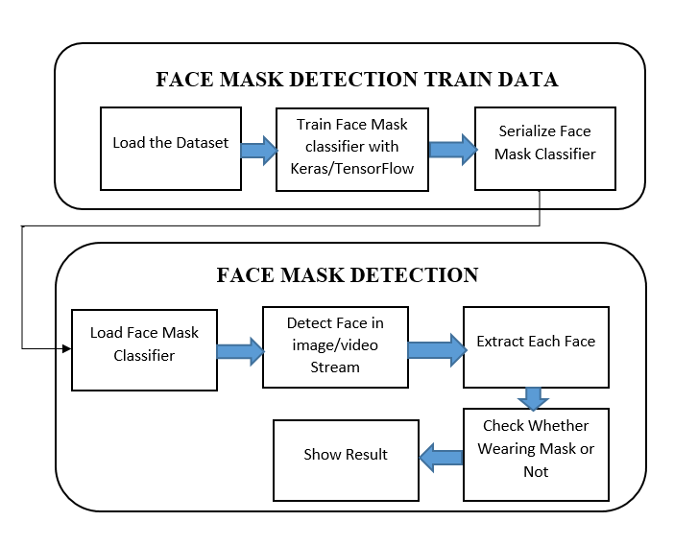
Methodology

Slide 8
Transfer Learning
Transfer learning is a machine learning technique that involves using knowledge gained from one task to improve the performance of a related but different task.
Transfer Learning with MobileNetV2:
In our research, we embrace transfer learning with MobileNetV2 as the base model.
Two Core Components: FaceNet and MaskNet:
Face Detection (FaceNet)
Face Mask Classification (MaskNet)

Slide 9
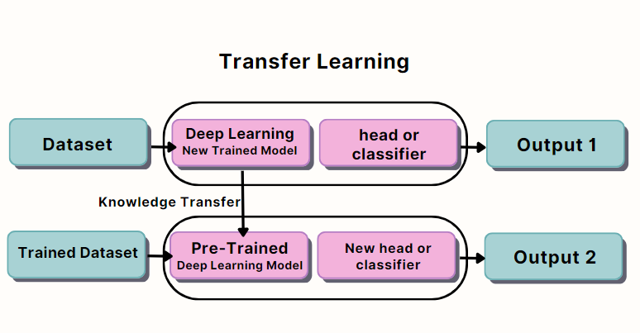
Transfer Learning Diagram

Slide 10
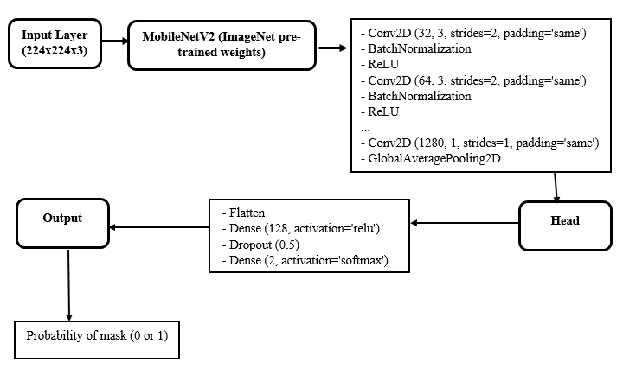
Model Training

Slide 11
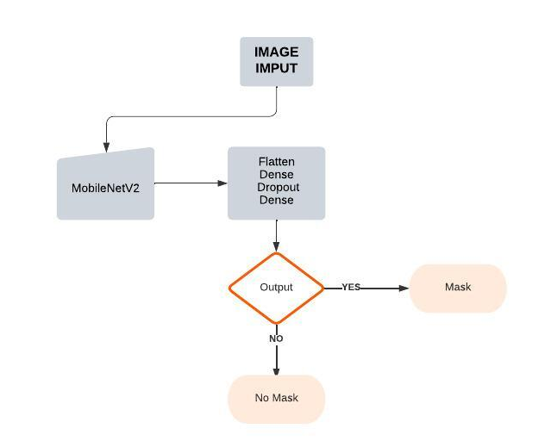
Model Evaluation

Slide 12
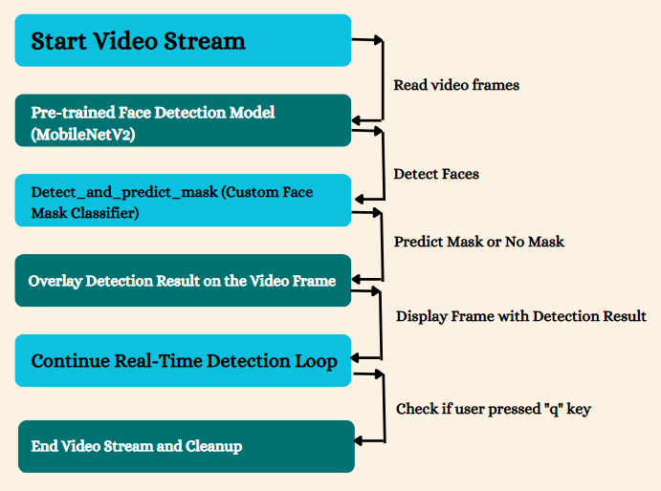
Real Time Detection

Slide 13
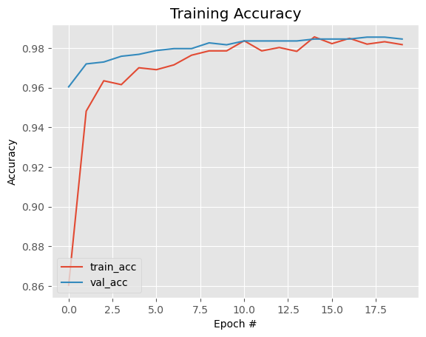
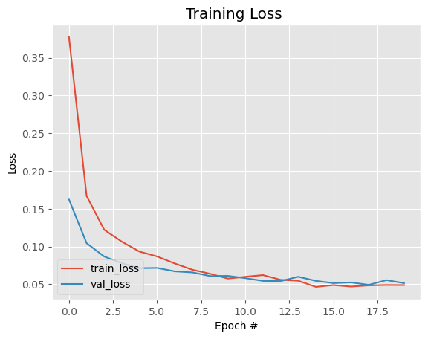
Result Analysis
In addition to training accuracy, we also kept a close eye on validation accuracy. Validation accuracy measures how well the model performs on data it hasn't seen during training. It serves as a crucial indicator of our model's ability to generalize to new scenarios.

Slide 14
Result Analysis
Our journey in building an efficient face mask detection system has culminated in a triumph of accuracy. Let's delve into the results of our experiments and what they mean for our project.
Masked Faces Detection: Our model achieved a remarkable 97.87% accuracy in detecting individuals wearing face masks.
Unmasked Faces Identification: Equally impressive, our model reached 98.46% accuracy in identifying individuals without face masks.
Overall Model Accuracy: The total model, encompassing both masked and unmasked face detection, achieved an impressive 98.33% accuracy rate.

Slide 15
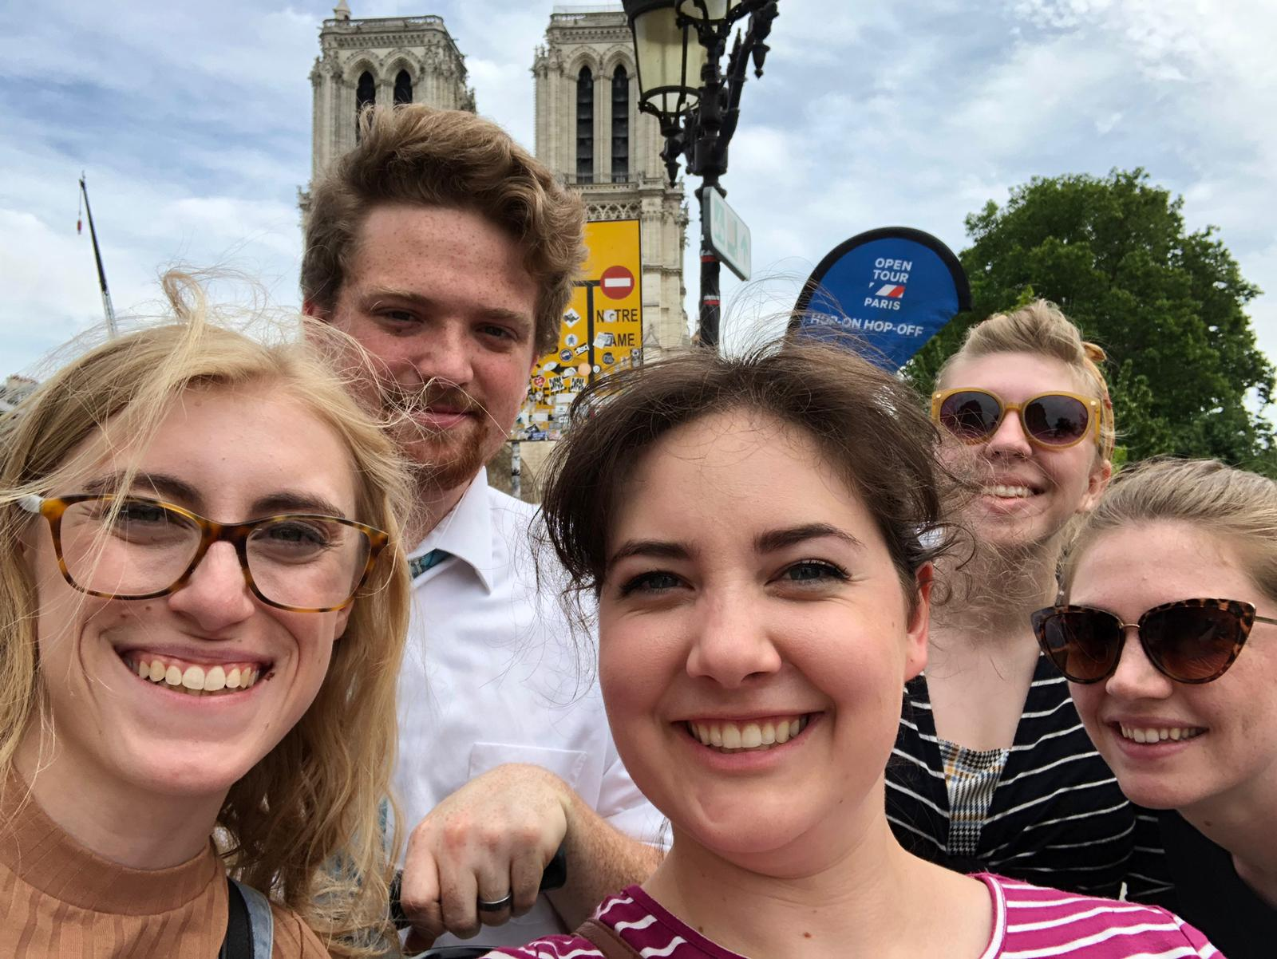





No Mask Detection
Mask100%
Mask100%
Mask100%
Mask100%
Mask100%
Mask100%
Mask100%
Mask100%
Mask100%
Mask100%
Mask100%
Mask100%
Mask100%
Mask100%
Mask100%
Mask100%

Slide 16
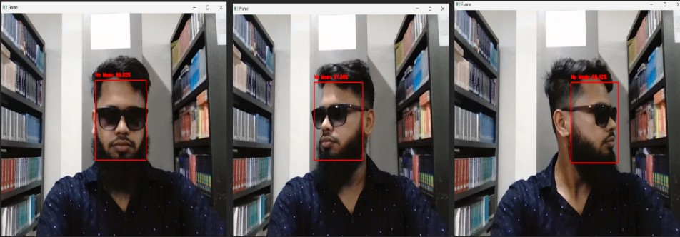
No Mask Detection
No Mask100%
No Mask100%
No Mask100%
No Mask100%
No Mask100%
No Mask100%
No Mask100%

Slide 17
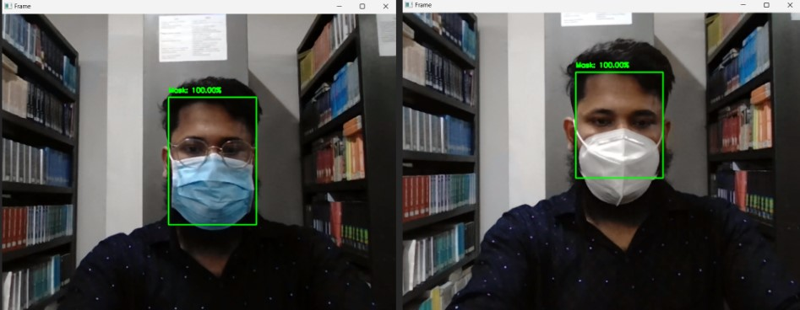
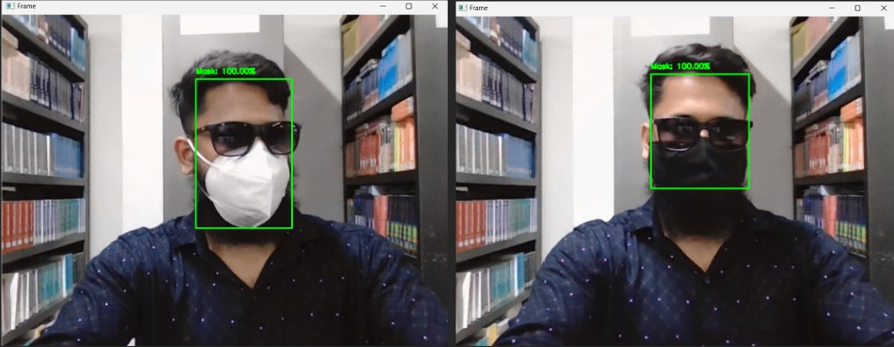
Different Type of Mask Detection

Slide 18
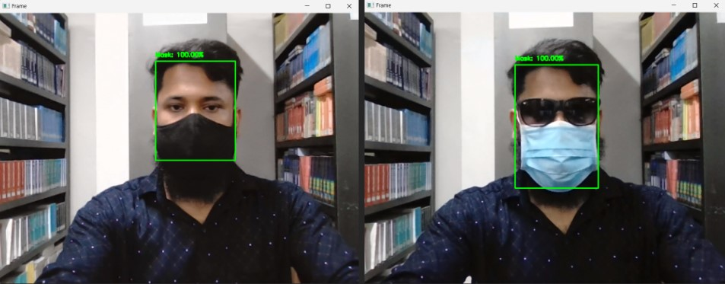
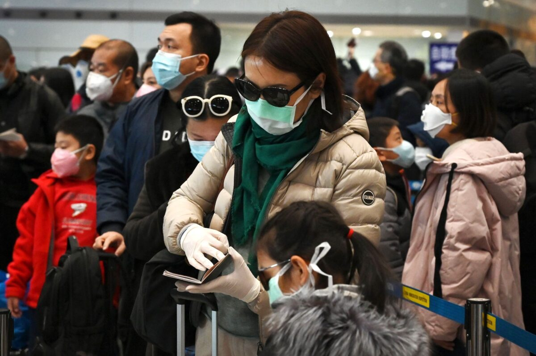
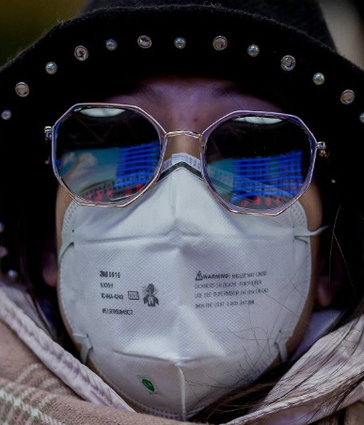
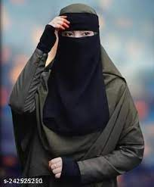
Different Type of Mask Detection
Mask100%
Mask100%
Mask100%
Mask100%
Mask100%
Mask100%
Mask100%
Mask100%
Mask100%
Mask100%

Slide 19
Conclusion
In this journey through face mask detection, we've achieved remarkable results. Our model, powered by computer vision and machine learning, boasts a 98.33% accuracy rate, signifying its prowess in identifying masked and unmasked individuals.
As we look ahead, we see boundless opportunities for improvement and innovation. Our mission continues, driven by a vision of a safer and healthier world, where technology and compassion intersect.

Slide 20
Thanks!
Do you have any questions?

